Slide 1

Unit-2: Wireless Communication Technology PART-4 : Coding and Error Control
Mobile Computing and Wireless Communication (MCWC)
GTU # 3170710
Prof.Swati R Sharma
Computer Engineering Department
swati.sharma@darshan.ac.in
(O) 9727747317

Slide 2
Coding and Error Control

Looping
Topics to be covered- Coding and Error Control
Error Detection
Block Error Correction Codes
Convolutional Codes
Automatic Repeat Request

Slide 3

Coding and Error Control
For reliable communication, errors must be detected and corrected.
A situation in which received information doesn’t match with the sender’s information.
At the time of transmission a digital signal may suffer from noise, that introduces errors in the data.
It means a 0 bit may change to 1 or a 1 bit may change to 0.
Data-link layer uses some error control mechanism to ensure that frames (data bit streams) are transmitted with certain level of accuracy.
Need to understand how errors is controlled and to know what types of errors may occur.
Error detection and correction are implemented either at the data link layer or the transport layer of the OSI model.

Slide 4
Coding and Error Control
Regardless of the design of the transmission system, there will be errors, resulting in the change of one or bits in a transmitted frame.
Three approaches are used to deal with data transmission errors:
Error detection codes
Detects the presence of an error
Automatic repeat request (ARQ) protocols
Receiver discards a block of data in which an error is detected
Transmitter retransmits that block of data
Error correction codes, or forward correction codes (FEC)
Designed to detect and correct errors
Avoiding the need for retransmission because retransmission is highly inefficient and error rates may be high.

Slide 5
Types of Errors

Slide 6
Types of Errors
Frame contains more than1 consecutive bits corrupted.
Frame is received with more than one bits in corrupted state.
In a frame, there is only one bit, anywhere though, which is corrupt.

Slide 7
Error Detection

Slide 8

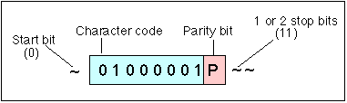
Error Detection
When a message is transmitted, it may get scrambled due to noise or data may get corrupted.
To avoid this, we use error-detecting codes that are additional data added to a given digital message to help us detect if an error occurred during transmission of the message.
E.g. parity check
0101110011
1000010111
1000000011
1111110000
0110011001

Slide 9

Error Detection Process
Transmitter
Receiver
01100011
Transmitter
For a given frame, an error-detecting code (check bits) is calculated from data bits
Check bits are appended to data bits
Receiver
Separates incoming frame into data bits and check bits
Calculates check bits from received data bits
Compares calculated check bits against received check bits
Detected error if mismatch occurs

Slide 10
Error Detection Techniques

Slide 11
Error Detection Techniques
Error Detection Techniques
Parity Check
Cyclic Redundancy Check (CRC)
Checksum

Slide 12
Parity Check

Slide 13
Parity Check
A parity check is the process that ensures accurate data transmission between nodes during communication.
A parity bit is appended to the original data bits
Parity Check
Even Parity Check
no. of "1 bits" in the entire word is even.
Odd Parity Check
no. of "1 bits" in the entire word is odd.

Slide 14
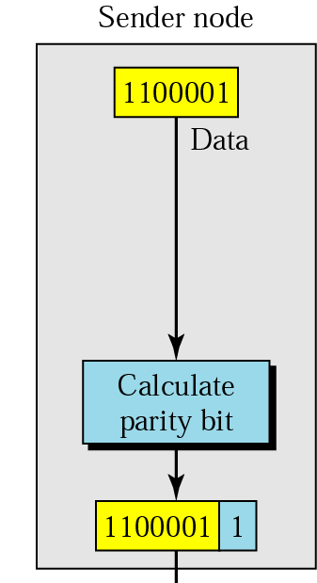
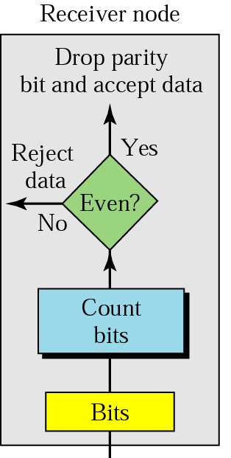
Error Detection in Parity check
Parity checking at the receiver can be detected by the presence of an error if the parity of the receiver signal is different from the expected parity.
It means, if it is known that the parity of the transmitted signal is always going to be "even" and if the received signal has an odd parity, then the receiver can conclude that the received signal is not correct.
If an error is detected, then the receiver will ignore the received byte and request for retransmission of the same byte to the transmitter.
Drawback of parity check
If two (or any even number of bits are inverted due to errors), an undetected error occurs.
Transmission Medium

Slide 15
Error Detection Techniques
Error Detection Techniques
Parity Check
Cyclic Redundancy Check
Checksum

Slide 16
Cyclic Redundancy Check

Slide 17
Cyclic Redundancy Check
CRC or Cyclic Redundancy Check is a method of detecting accidental changes/errors in the communication channel.
CRC is based on binary division.
In CRC, a sequence of redundant bits, called cyclic redundancy check bits, are appended to the end of data unit so that the resulting data unit becomes exactly divisible by a second, predetermined binary number.
At the destination, the incoming data unit is divided by the same number. If at this step there is no remainder(zero remainder), the data unit is assumed to be correct and is therefore accepted.
A non-zero remainder indicates that the data unit has been damaged in transit and therefore must be rejected.

Slide 18
Cyclic Redundancy Check: Example (Transmitter)
Given: Data=1101101
Divisor=10101
Dividend (data+n-bit(0)) = 11011010000
n-bit->appending ‘0’-bit n times, where n is 1-bit less than divisor
0
1
1
1
1
1
1
10101
1 | 1 | 0 | 1 | 1 | 0 | 1 | 0 | 0 | 0 | 0
⊕
1 | 0 | 1 | 0 | 1
0
1
1
1
0
0
⊕
1 | 0 | 1 | 0 | 1
0
1
0
0
1
1
⊕
1 | 0 | 1 | 0 | 1
0
0
1
1
0
0
⊕
0 | 0 | 0 | 0 | 0
0
1
1
0
0
0
⊕
1 | 0 | 1 | 0 | 1
0
1
1
0
1
0
⊕
1 | 0 | 1 | 0 | 1
0
1
1
1
1
0
⊕
1 | 0 | 1 | 0 | 1
Remainder (CRC)= 1011
Now, at the receiver end, Remainder = 1011 is appended to Data=1101101
Therefore, Transmitter will send Data=11011011011
0
1
0
1
1

Slide 19
Cyclic Redundancy Check: Example (Receiver)
Quotient
Not used
Divisor
Dividend
Content of frame
Generator Polynomial
Remainder
Used for calculating checksum

Slide 20
Cyclic Redundancy Check: Example (Receiver)
Given: Data Received= 11011011011
Divisor=10101
0
1
1
1
1
1
1
10101
1 | 1 | 0 | 1 | 1 | 0 | 1 | 1 | 0 | 1 | 1
⊕
1 | 0 | 1 | 0 | 1
0
1
1
1
0
0
⊕
1 | 0 | 1 | 0 | 1
0
1
0
0
1
1
⊕
1 | 0 | 1 | 0 | 1
0
0
1
1
0
1
⊕
0 | 0 | 0 | 0 | 0
0
1
1
0
1
0
⊕
1 | 0 | 1 | 0 | 1
0
1
1
1
1
1
⊕
1 | 0 | 1 | 0 | 1
0
1
0
1
0
1
⊕
1 | 0 | 1 | 0 | 1
Remainder = 00000
0
0
0
0
0

Slide 21
Cyclic Redundancy Check: Error Example (Receiver)
Given: Data Received= 11011011011
Data Received= 11011001011
Divisor=10101
0
1
1
0
1
1
1
10101
1 | 1 | 0 | 1 | 1 | 0 | 0 | 1 | 0 | 1 | 1
⊕
1 | 0 | 1 | 0 | 1
0
1
1
1
0
0
⊕
1 | 0 | 1 | 0 | 1
0
1
0
0
1
0
⊕
1 | 0 | 1 | 0 | 1
0
0
1
1
1
1
⊕
0 | 0 | 0 | 0 | 0
0
1
1
1
1
0
⊕
1 | 0 | 1 | 0 | 1
0
1
0
1
1
1
⊕
1 | 0 | 1 | 0 | 1
0
0
0
1
0
1
⊕
0 | 0 | 0 | 0 | 0
Remainder = 0101 (which is non-zero)
0
0
1
0
1

Slide 22
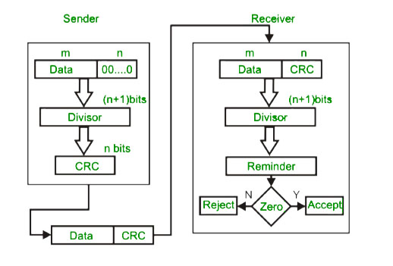
Cyclic Redundancy Check : Flowchart

Slide 23
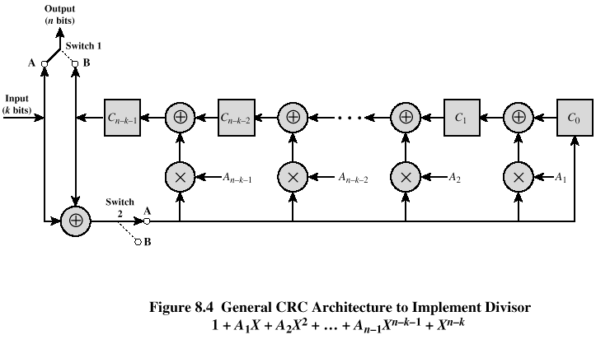
Cyclic Redundancy Check : Digital Logic CRC

Slide 24
Cyclic Redundancy Check: Exercise
Given: Data=1010000
Divisor=1001
Dividend (data+n-bit(0)) = 1010000000
n-bit->appending ‘0’-bit n times, where n is 1-bit less than divisor
ANS: CRC=011

Slide 25
Error Detection Techniques
Error Detection Techniques
Parity Check
Cyclic Redundancy Check
Checksum

Slide 26
Checksum
For error detection by checksums, data is divided into fixed sized frames or segments(k-segments).
For each k-segments, it contains m-bits
For E.g:There are 11001100, 10101010, 11110000 and 11000011 data, so 4 frames/segments, therefore
k=4
m=8
Sender | Receiver
Step-1:Segments are added using 1’s complement arithmetic to get the sum. Step-2:Sum is complemented to get the checksum. Step-3:Checksum segment is sent along with the data segments.
Step-1:All received segments are added using 1’s complement arithmetic to get complemented sum. Step-2:If the result is zero, the received data is accepted; otherwise discarded.

Slide 27
Checksum: Example
Frame 1 | 11001100
Frame 3 | 11110000
Given frames, where k=4 and m=8
Frame 2 | 10101010
Frame 4 | 11000011
Sender | Receiver
Frame 1: 1 1 0 0 1 1 0 0 Frame 2: 1 0 1 0 1 0 1 0 Ans:
Frame 1: 1 1 0 0 1 1 0 0 Frame 2: 1 0 1 0 1 0 1 0 Ans: Add carry-bit
1
1
1
1
+
+
+
0
1
1
1
0
1
1
0
+
0
1
1
1
0
1
1
0
Add carry-bit
1
1
1
1
1
1
1
1
1
1
0
1
1
1
0
1
1
1
0
1
1
1
0
1
1
1
Frame 3:
+
1 1 1 1 0 0 0 0
Frame 3:
+
1 1 1 1 0 0 0 0
1
1
1
1
1
1
0
1
1
0
0
1
1
1
0
1
1
0
0
1
1
1
Add carry-bit
+
1
Add carry-bit
+
1
1
1
1
1
+
0
1
1
0
1
0
0
0
+
0
1
1
0
1
0
0
0
Frame 4:
1 1 0 0 0 0 1 1
Frame 4:
1 1 0 0 0 0 1 1
1
1
1
1
Add carry-bit
0
0
1
0
1
0
1
1
Add carry-bit
0
0
1
0
1
0
1
1
+
1
+
1
0
0
1
0
1
1
0
0
0
0
1
0
1
1
0
0
1’s compliment
Checksum
1’s compliment
Checksum
+
1 1 0 1 0 0 1 1
0 0 0 0 0 0 0 0
1 1 0 1 0 0 1 1
1 1 1 1 1 1 1 1
Accept Data

Slide 28
Checksum: Example with Error
Frame 1 | 11001100
Frame 3 | 11110000
Given frames, where k=4 and m=8
Frame 2 | 10101010
Frame 4 | 11000011
Sender | Receiver
Frame 1: 1 1 0 0 1 1 0 0 Frame 2: 1 0 1 0 1 0 1 0 Ans: Add carry-bit
Frame 1: 1 1 0 0 1 1 0 0 Frame 2: 1 0 1 0 1 0 1 0 Ans: Add carry-bit
1
1
1
1
+
+
+
0
1
1
1
0
1
1
0
+
0
1
1
1
0
1
1
0
1
1
1
1
1
1
1
1
1
1
0
1
1
1
0
1
1
1
0
1
1
1
0
1
1
1
Frame 3:
+
1 1 1 1 0 0 0 0
Frame 3:
+
1 1 1 1 0 0 0 0
1
1
1
1
1
1
0
1
1
0
0
1
1
1
0
1
1
0
0
1
1
1
Add carry-bit
+
1
Add carry-bit
+
1
1
1
1
1
+
0
1
1
0
1
0
0
0
+
0
1
1
0
1
0
0
0
Frame 4:
1 1 0 0 0 0 1 1
Frame 4:
1 1 0 0 0 0 1 1
1
1
1
1
Add carry-bit
0
0
1
0
1
0
1
1
Add carry-bit
0
0
1
0
1
0
1
1
+
1
+
1
0
0
1
0
1
1
0
0
0
0
1
0
1
1
0
0
1’s compliment
Checksum
1’s compliment
Checksum
+
1 1 0 1 0 0 0 1
0 0 0 0 0 0 1 0
1 1 0 1 0 0 1 1
1 1 1 1 1 1 0 1
Reject Data

Slide 29
Checksum: Exercise
Frame 1 | 10011001
Frame 3 | 00100100
Frame 2 | 11100010
Frame 4 | 10000100
Sum: 00100101
Checksum: 11011010

Slide 30
Wireless Transmission Errors
Error detection requires retransmission
Detection inadequate for wireless applications
Error rate on wireless link can be high, results in a large number of retransmissions
Long propagation delay compared to transmission time
Therefore, for wireless transmission, error detection scheme is inadequate.

Slide 31
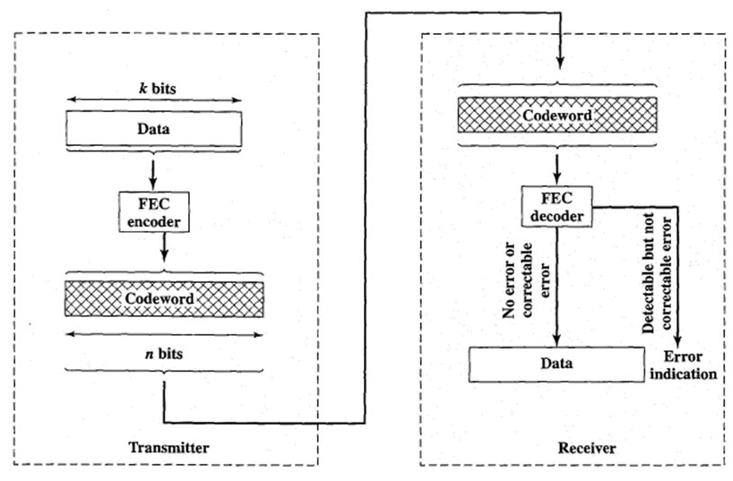
Block Error Correction Codes: FEC process
Transmitter
Forward error correction (FEC) encoder maps each k-bit block into an n-bit block codeword
Codeword is transmitted; analog for wireless transmission
Receiver
Incoming signal is demodulated
Block passed through an FEC decoder
FEC decoder: Possible outcomes
A: No errors present, i.e. codeword matches with original codeword
B: Decoder detects and corrects bit errors
C: Decoder detects but cannot correct bit errors; reports uncorrectable error
D: Decoder detects no bit errors, though errors are present

Slide 32
Block Error Correction Codes
Error Detection
and Correction
codes
FEC
(Forward Error Correction)
BEC
(Backward Error Correction)
Block Error Codes
Convolution Codes
ARQ
(Automatic Repeat Request)
Hamming Code
Cyclic Code
BCH Code
Reed Solomon Code
Block Interleaving

Slide 33
Hamming Code
Hamming code is a block code that is capable of detecting up to two simultaneous bit errors and correcting single-bit errors.
It was developed by R.W. Hamming for error correction.
In this coding method, the source encodes the message by inserting redundant bits within the message.
These redundant bits are extra bits that are generated and inserted at specific positions in the message itself to enable error detection and correction.
When the destination receives this message, it performs recalculations to detect errors and find the bit position that has error.

Slide 34
Hamming Code: Encoding a message
Step 1 − Calculation of the number of redundant bits.
Step 2 − Positioning the redundant bits.
Step 3 − Calculating the values of each redundant bit.

Slide 35

Hamming Code Example: Encoding
Data: m=1011001(7-bit)
The number of redundant bits can be calculated by: 2^{r} ≥ m + r + 1
where, r = redundant bit, m = data bit
Step-1: Calculate value of redundant bit(r)
Formula: 2^{r} ≥ m+r+1
2^{r} ≥ 7+r+1
Assuming r=3: 2³ ≥ 7+3+1
8 ≥ 11
Assuming r=4: 2⁴ ≥ 7+4+1
16 ≥ 12
Therefore, r=4
Step-3:
X

Slide 36
Hamming Code Example
Data: m=1011001(7-bit)
Step-2: Positioning the redundant bits
The r redundant bits placed at bit positions of powers of 2, i.e. 1, 2, 4, 8, 16 etc.
They are referred in the rest of this text as r₁ (at position 1), r₂ (at position 2), r₃ (at position 4), r₄ (at position 8) and so on.
Data-bit+ redundant-bit= 7-bit+4-bit=11-bit
Redundant bits= r1, r2, r4, r8
11 | 10 | 9 | 8 | 7 | 6 | 5 | 4 | 3 | 2 | 1
1
0
1
r8
1
0
0
r4
1
r2
r1

Slide 37
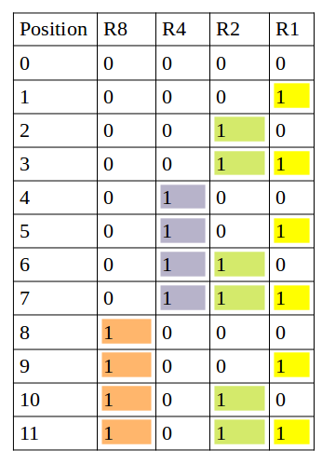
Hamming Code Example
Step-3: Calculating the values of each redundant bit
11 | 10 | 9 | 8 | 7 | 6 | 5 | 4 | 3 | 2 | 1
1
0
1
r8
1
0
0
r4
1
r2
r1
r1 | 1,3,5,7,9,11
r2 | 2,3,6,7,10,11
This example consider ‘EVEN PARITY’ bit
r4 | 4,5,6,7
r8 | 8,9,10,11

Slide 38
Hamming Code Example
Step-3: Calculating the values of each redundant bit
r1 | 1,3,5,7,9,11
11 | 10 | 9 | 8 | 7 | 6 | 5 | 4 | 3 | 2 | 1
r2 | 2,3,6,7,10,11
r4 | 4,5,6,7
1
0
1
r8
1
0
0
r4
1
r2
r1
r8 | 8,9,10,11
11
9
7
5
3
Even
Parity
r1
Value of r1=
1
1
1
0
1
0
11
10
7
6
3
Odd
Parity
r2
Value of r2=
1
0
1
0
1
1
7
6
5
Odd
Parity
r4
Value of r4=
1
0
0
1
11
10
9
Even
Parity
R8
Value of r8=
1
0
1
0
11 | 10 | 9 | 8 | 7 | 6 | 5 | 4 | 3 | 2 | 1
1
0
1
0
1
0
0
1
1
1
0

Slide 39
Hamming Code Example: Decoding
Step-4: decoding
11 | 10 | 9 | 8 | 7 | 6 | 5 | 4 | 3 | 2 | 1
1
0
1
0
1
0
0
1
1
1
0
11
9
7
5
3
1
Even
Parity
r1 | 1,3,5,7,9,11
r1=
0
r2 | 2,3,6,7,10,11
1
1
1
0
1
0
r4 | 4,5,6,7
11
10
7
6
3
2
Even
Parity
r2=
0
r8 | 8,9,10,11
1
0
1
0
1
1
7
6
5
4
Even
Parity
r4=
0
1
0
0
1
No Error
11
10
9
8
Even
Parity
r8=
0
1
0
1
0

Slide 40
Hamming Code Example: Decoding (Error)
Step-4: decoding
11 | 10 | 9 | 8 | 7 | 6 | 5 | 4 | 3 | 2 | 1
1
0
1
0
0
1
0
1
1
1
0
11
9
7
5
3
1
Even
Parity
r1 | 1,3,5,7,9,11
r1=
0
r2 | 2,3,6,7,10,11
1
1
1
0
1
0
r4 | 4,5,6,7
11
10
7
6
3
2
Odd
Parity
r2=
1
r8 | 8,9,10,11
1
0
1
1
1
1
7
6
5
4
Odd
Parity
r4=
1
1
1
0
1
11
10
9
8
Even
Parity
r8=
0
1
0
1
0
Value=0110=>6(binary)
Error detected in bit 6
Error will be corrected after changing bit 6 from ‘1’ to ‘0’

Slide 41
Hamming Code Example: Decoding (Error)
Step-4: decoding
11 | 10 | 9 | 8 | 7 | 6 | 5 | 4 | 3 | 2 | 1
1
0
1
0
0
0
0
1
1
1
0
11
9
7
5
3
1
Odd
Parity
r1 | 1,3,5,7,9,11
r1=
1
r2 | 2,3,6,7,10,11
1
1
0
0
1
0
r4 | 4,5,6,7
11
10
7
6
3
2
Odd
Parity
r2=
1
r8 | 8,9,10,11
1
0
0
0
1
1
7
6
5
4
Odd
Parity
r4=
1
0
0
0
1
11
10
9
8
Even
Parity
r8=
0
1
0
1
0
Value=0111=>7(binary)
Error detected in bit 7
Error will be corrected after changing bit 7 from ‘1’ to ‘0’

Slide 42
Hamming Code Example: Exercise
Data: 1 0 0 1 1 0 1
Data
1
0
0
1
1
0
1
Adding r1
1
0
0
1
1
0
1
1
Adding r2
1
0
0
1
1
0
1
0
1
Adding r4
1
0
0
1
1
0
0
1
0
1
Adding r8
1
0
0
1
1
1
0
0
1
0
1
Data: 1 0 0 1 1 1 0 0 1 0 1

Slide 43
Hamming Code Example: Exercise
Error in transmission:
Error bit Detection
Sent
Received
1
0
0
1
1
1
0
0
1
0
1
1
0
0
1
0
1
0
0
1
0
1
Error
11
10
9
8
7
6
5
4
3
2
1
1
0
0
1
0
1
0
0
1
0
1
11
10
9
8
7
6
5
4
3
2
1
1
0
0
1
0
1
0
0
1
0
1
11
10
9
8
7
6
5
4
3
2
1
1
0
0
1
0
1
0
0
1
0
1
11
10
9
8
7
6
5
4
3
2
1
1
0
0
1
0
1
0
0
1
0
1
The bit in position 7 is in error
0
1
1
1
7

Slide 44
Block Error Correction Codes
Error Detection
and Correction
codes
FEC
(Forward Error Correction)
BEC
(Backward Error Correction)
Block Error Codes
Convolution Codes
ARQ
(Automatic Repeat Request)
Hamming Code
Cyclic Code
BCH Code
Reed Solomon Code
Block Interleaving

Slide 45
Cyclic Code
The cyclic property of code words is that any cyclic-shift of a code word is also a codeword.
Cyclic codes follow this cyclic property
For a linear code C, if every code word i.e., C = C1,C2,......Cn from C has a cyclic right shift of components, it becomes a code word.
This shift of right is equal to n-1 cyclic left shifts. Hence, it is invariant under any shift.
So, the linear code C, as it is invariant under any shift, can be called as a Cyclic code.
Cyclic codes are used for error correction.
They are used to correct double errors and burst errors.

Slide 46
Cyclic Code
There are two important property of cyclic code
Property of Linearity
Property of Shifting

Slide 47
Cyclic Code: Example 1
Data = { 0000, 0110, 1001, 1111 }
Rule for Linearity:
A⊕B=C⊕D
A⊕C=B⊕D
B⊕C=A⊕D
A
B
C
D
A⊕B
C⊕D
 | 0 | 0 | 0 | 0
⊕ | 0 | 1 | 1 | 0
 | 0 | 1 | 1 | 0
 | 1 | 0 | 0 | 1
⊕ | 1 | 1 | 1 | 1
 | 0 | 1 | 1 | 0
=
A⊕C
B⊕D
 | 0 | 0 | 0 | 0
⊕ | 1 | 0 | 0 | 1
 | 1 | 0 | 0 | 1
 | 0 | 1 | 1 | 0
⊕ | 1 | 1 | 1 | 1
 | 1 | 0 | 0 | 1
Therefore, the Code is Linear
=
B⊕C
A⊕D
 | 0 | 1 | 1 | 0
⊕ | 1 | 0 | 0 | 1
 | 1 | 1 | 1 | 1
 | 0 | 0 | 0 | 0
⊕ | 1 | 1 | 1 | 1
 | 1 | 1 | 1 | 1
=

Slide 48
Cyclic Code: Example 1
Data = { 0000, 0110, 1001, 1111 }
Rule for Shifting: Cyclic right shifts
Right-shift A
A
B
C
D
0 | 0 | 0 | 0
Right-shift B
0 | 1 | 1 | 0
0 | 0 | 0 | 0
= A
0 | 0 | 1 | 1
=X
0 | 0 | 0 | 0
= A
Right-shift C
1 | 0 | 0 | 1
Right-shift D
1 | 1 | 1 | 1
1 | 1 | 0 | 0
= X
1 | 1 | 1 | 1
= D
1 | 1 | 1 | 1
=D
This code doesn’t follows one of the rule:
Rule for Linearity √
Rule for Shifting X
Therefore, this is NOT cyclic code

Slide 49
Cyclic Code: Example 2
Data = { 0000, 0101, 1010, 1111 }
Rule for Linearity:
A⊕B=C⊕D
A⊕C=B⊕D
B⊕C=A⊕D
A
B
C
D
A⊕B
C⊕D
 | 0 | 0 | 0 | 0
⊕ | 0 | 1 | 0 | 1
 | 0 | 1 | 0 | 1
 | 1 | 0 | 1 | 0
⊕ | 1 | 1 | 1 | 1
 | 0 | 1 | 0 | 1
=
A⊕C
B⊕D
 | 0 | 0 | 0 | 0
⊕ | 1 | 0 | 1 | 0
 | 1 | 0 | 1 | 0
 | 0 | 1 | 0 | 1
⊕ | 1 | 1 | 1 | 1
 | 1 | 0 | 1 | 0
Therefore, the Code is Linear
=
B⊕C
A⊕D
 | 0 | 1 | 0 | 1
⊕ | 1 | 0 | 1 | 0
 | 1 | 1 | 1 | 1
 | 0 | 0 | 0 | 0
⊕ | 1 | 1 | 1 | 1
 | 1 | 1 | 1 | 1
=

Slide 50
Cyclic Code: Example 2
Data = { 0000, 0101, 1010, 1111 }
Rule for Shifting:
Right-shift A
A
B
C
D
0 | 0 | 0 | 0
Right-shift B
0 | 1 | 0 | 1
0 | 0 | 0 | 0
= A
1 | 0 | 1 | 0
= C
0 | 0 | 0 | 0
= A
0 | 1 | 0 | 1
=B
1 | 0 | 1 | 0
= C
Right-shift C
1 | 0 | 1 | 0
Right-shift D
1 | 1 | 1 | 1
0 | 1 | 0 | 1
= B
1 | 1 | 1 | 1
= D
1 | 0 | 1 | 0
= C
1 | 1 | 1 | 1
=D
0 | 1 | 0 | 1
= B
This code follows both:
Rule for Linearity
Rule for Shifting
Therefore, this is cyclic code

Slide 51
Cyclic Code: Example 2(wrong example)
Data Sent = { 0000, 0101, 1010, 1111 } Data Received = { 0001, 0101, 1010, 1111 }
Rule for Linearity:
A⊕B=C⊕D
A⊕C=B⊕D
B⊕C=A⊕D
A
B
C
D
A⊕B
C⊕D
 | 0 | 0 | 0 | 1
⊕ | 0 | 1 | 0 | 1
 | 0 | 1 | 0 | 0
 | 1 | 0 | 1 | 0
⊕ | 1 | 1 | 1 | 1
 | 0 | 1 | 0 | 1
≠
A⊕C
B⊕D
 | 0 | 0 | 0 | 1
⊕ | 1 | 0 | 1 | 0
 | 1 | 0 | 1 | 1
 | 0 | 1 | 0 | 1
⊕ | 1 | 1 | 1 | 1
 | 1 | 0 | 1 | 0
Therefore, the Code is NOT Linear
≠
B⊕C
A⊕D
 | 0 | 1 | 0 | 1
⊕ | 1 | 0 | 1 | 0
 | 1 | 1 | 1 | 1
 | 0 | 0 | 0 | 1
⊕ | 1 | 1 | 1 | 1
 | 1 | 1 | 1 | 0
≠

Slide 52
Cyclic Code: Example 2
Data = { 0000, 0101, 1010, 1111 } Data Received = { 0001, 0101, 1010, 1111 }
Rule for Shifting:
Right-shift A
A
B
C
D
0 | 0 | 0 | 1
Right-shift B
0 | 1 | 0 | 1
1 | 0 | 0 | 0
= X
1 | 0 | 1 | 0
= C
0 | 1 | 0 | 0
= X
0 | 1 | 0 | 1
=B
1 | 0 | 1 | 0
= C
Right-shift C
1 | 0 | 1 | 0
Right-shift D
1 | 1 | 1 | 1
0 | 1 | 0 | 1
= B
1 | 1 | 1 | 1
= D
1 | 0 | 1 | 0
= C
1 | 1 | 1 | 1
=D
0 | 1 | 0 | 1
= B
Therefore, from both the property we can conclude that
Error is present in Block -A

Slide 53
Features of Cyclic code
The cyclic codes have a very good performance in detecting
single-bit errors
double errors
odd number of errors
burst errors
They can easily be implemented in hardware and software.
They are especially fast when implemented in hardware.

Slide 54
Block Error Correction Codes
Error Detection
and Correction
codes
FEC
(Forward Error Correction)
BEC
(Backward Error Correction)
Block Error Codes
Convolution Codes
ARQ
(Automatic Repeat Request)
Hamming Code
Cyclic Code
BCH Code
Reed Solomon Code
Block Interleaving

Slide 55
BCH Codes

Slide 56
BCH Codes
BCH codes are named after the inventors Bose, Chaudari and Hocquenghem.
Subset of cyclic code
During the BCH code design, there is control on the number of symbols to be corrected and hence multiple bit correction is possible.
BCH codes is a powerful technique in error correcting codes.
For any positive integers m ≥ 3 and t < 2^{m-1} there exists a BCH binary code.
Following are the parameters of BCH code:
Block length n = 2^{m}-1 (where m is any positive integer and m ≥ 3)
Number of message bits: k ≥ n-mt (t is no. of bits a BCH code can detect and correct error)
Minimum distance d_{min} ≥ 2t + 1
This code can be called as t-error-correcting BCH code

Slide 57
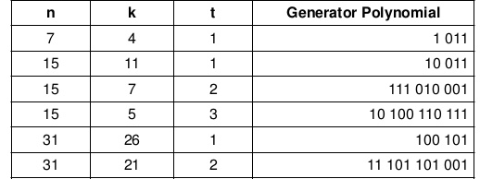
BCH Codes
Polynomial P(X)
X³+X+1
X⁴+X+1
X⁸+X⁷+X⁶+X⁴+1
X¹⁰+X⁸+X⁵+X⁴+X²+X+1
X⁵+X²+1
X¹⁰+X⁹+X⁸+X⁶+X⁵+X³+1
The central idea is to compute an error-locator polynomial and solve for its roots.
The complexity of the algorithm increases only as the square of the number of errors to be corrected.

Slide 58
Reed-Solomon Codes

Slide 59

Reed-Solomon Codes
Reed - Solomon error correcting codes are one of the oldest codes that were introduced in 1960s by Irving S. Reed and Gustave Solomon
Reed-Solomon (RS) codes are a widely used subclass of non-binary BCH codes
With RS codes, data are processed in chunks of m bits, called symbols
An (n, k), RS (Reed-Solomon Codes) code has the following parameters:
Thus, the encoding algorithm expands a block of k symbols to n symbols by adding n - k redundant check symbols.
Typically, m is a power of 2; a popular value of m is 8
Symbol length: | m bits per symbol
Block length: | n = 2^{m} – 1 [symbols = m(2^{m} – 1) bits]
Data length: | k symbols
Size of check code: | n – k = 2t [symbols = m(2t) bits]
Minimum distance: | dmin = 2t + 1 symbols

Slide 60
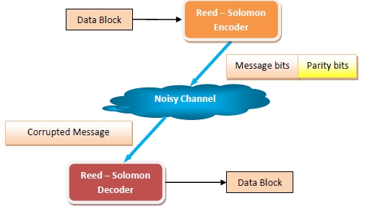
Reed-Solomon Codes
A Reed - Solomon encoder accepts a block of data and adds redundant bits (parity bits) before transmitting it over noisy channels.
On receiving the data, a decoder corrects the error depending upon the code characteristics.

Slide 61
Reed-Solomon Codes
Given: t=1
m=2
K=4
Denoting the symbol as 0,1,2,3 we can write their binary equivalents as
0->00
1->01
2->10
3->11
The code has following parameters:
n = 2^{m}-1 = 2² - 1 = 3 Symbols = 6 bits
(n-k) = 2 Symbols = 4 bits
Therefore, this code can correct any burst error that spans a symbol of 2 bits.

Slide 62
Reed-Solomon Codes: Application
Storage areas like CDs, DVDs, Blu-ray Discs
High speed data transmission technologies such as DSL and WiMAX
High speed modems
QR Codes
Broadcast systems such as satellite communications
Storage systems such as RAID 6

Slide 63
Block Interleaving

Slide 64
Block Interleaving
Interleaving is a tool that is used to enhance existing error correcting codes so that they can be used to perform burst error correction
Most error correcting codes (ECCs) are designed to correct random errors, i.e. error caused by additive noise that is independent of each other.
Burst error are the errors that occur in a sequence or as groups.
They are caused due to defects in storage media or disruption in communication signals due to external factors like lightning etc.
Interleaving modifies the ECC or does some processing on the data after they are encoded by ECCss as well.

Slide 65
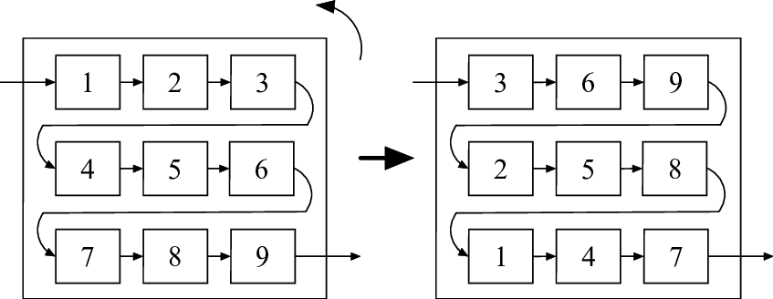
Block Interleaving Process
In Block Interleaving Process, the message is ordered in a repeating sequence of bytes.
The interleaver accepts data symbols in blocks and performs identical permutations on the blocks before transmitting them.
For example, the sequential blocks of code may be written to a matrix in a row-wise manner and then read out from the matrix in a column-wise manner. This method is known as Periodic Interleaving

Slide 66
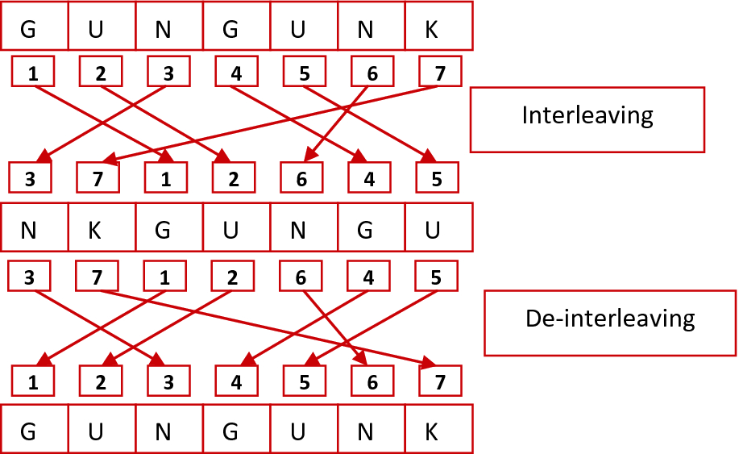
Block Interleaving: Example

Slide 67
Block Error Correction Codes
Error Detection
and Correction
codes
FEC
(Forward Error Correction)
BEC
(Backward Error Correction)
Block Error Codes
Convolution Codes
ARQ
(Automatic Repeat Request)
Hamming Code
Cyclic Code
BCH Code
Reed Solomon Code
Block Interleaving

Slide 68
Convolutional Codes

Slide 69
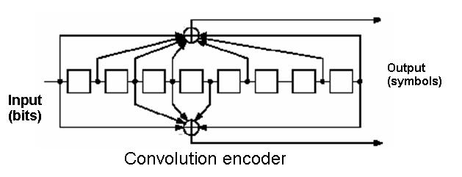
Convolutional Codes
The convolutional coding has been one of the most widely used error corrections in digital wireless communication.
Generates redundant bits continuously
Error checking and correcting carried out continuously
If data are transmitted and received in a more or less continuous stream, a block code, particularly one with a large value of n, may not be as convenient as a code that generates redundant bits continuously so that error checking and correcting are carried out continuously.

Slide 70
Convolutional Codes
In block codes, the data comprises of a block of data of a definite length.
However, in convolutional codes, the input data bits are not divided into block but are instead fed as streams of data bits, which convolve to output bits based upon the logic function of the encoder.
Unlike block codes, where the output codeword is dependent only on the present inputs, whileT in convolutional codes, output stream depends not only the present input bits but also only previous input bits stored in memory.

Slide 71
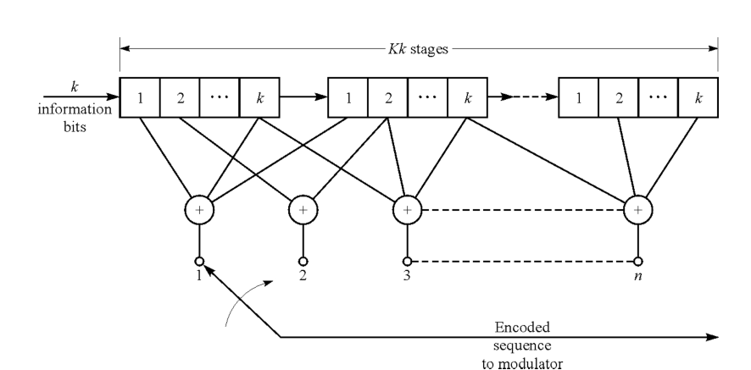
Convolutional Codes: Example
(n,k,K)=(n,4,3), where k=1101
A convolutional code is specified by three parameters
k: message bits
n: codeword bits
K: Constraint length
Don’t send message bits, send only parity bits
Use a sliding window to select which message bits may participate in the parity calculations

Slide 72
Convolutional Codes: Example 1
Don’ t send message bits, send only parity bits
1 | 2 | 3 | 4 | 5 | 6 | 7 | 8 | 9 | 10 | 11
1 | 0 | 1 | 1 | 0 | 1 | 0 | 0 | 1 | 0 | 1
k=1011
K=3(encoder memory)
Find n(codeword)

Slide 73
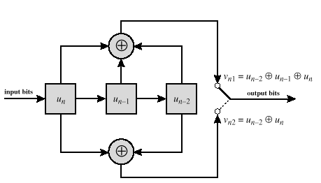
Convolutional Codes: Example 1
1 | 2 | 3 | 4 | 5 | 6 | 7 | 8 | 9 | 10 | 11
1 | 0 | 1 | 1 | 0 | 1 | 0 | 0 | 1 | 0 | 1
m2
m1
m0
k=
1 | 0 | 1 | 1
Time | Input | Shift register |  |  | Output
 |  | m0 | m1 | m2 | X1 | X2
-1 | - | 0 | 0 | 0 | 0 | 0
1
1
0 | 1 | 1 | 0 | 0
0
X1=m0 ⊕ m1 ⊕ m2
X2=m0 ⊕ m2
1
1 | 0 | 0 | 1 | 0
2 | 1 | 1 | 0 | 1
0
0
1
3 | 1 | 1 | 1 | 0
0
1
4 | 0 | 0 | 1 | 1
0
1
1
5 | 0 | 0 | 0 | 1
1
0
0
0
n=
1
1
0
0
1
1
1
1

Slide 74
Convolutional Codes: Example 1 state diagram
Time | Input | Shift register |  |  | Output
 |  | m0 | m1 | m2 | X1 | X2
Input | Previous State | Next State
a=00
-1 | 0 | 0 | 0 | 0 | 0 | 0
0 | 00
11
1
1
01
0 | 1 | 1 | 0 | 0
1 | 00
1
0
1 | 0 | 0 | 1 | 0
0 | 10
00
b=10
2 | 1 | 1 | 0 | 1
1 | 10
0
0
--
1
11
3 | 1 | 1 | 1 | 0
0 | 01
0
1
1 | 01
4 | 0 | 0 | 1 | 1
01
0
1
1
00
c=01
5 | 0 | 0 | 0 | 1
0 | 11
a= | 00
b= | 10
c= | 01
d= | 11
1 | 11
10
Input 1: | ---------->
Input 0:
d=11

Slide 75
Automatic Repeat Request (ARQ)

Slide 76
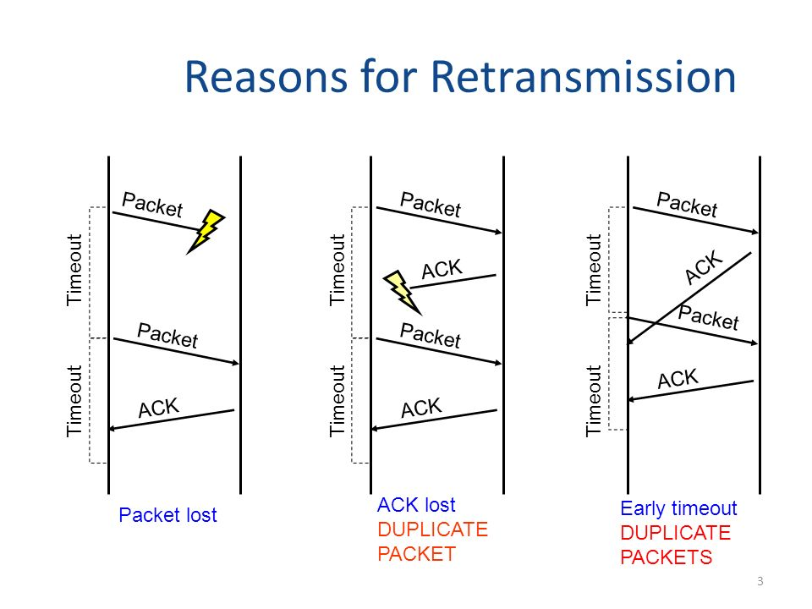
Automatic Repeat Request (ARQ)
ARQ Mechanism used in data link control and transport protocols
Automatic Repeat ReQuest (ARQ) is a group of error control protocols for transmission of data over noisy or unreliable communication network.
They are named so because they provide for automatic retransmission of frames that are corrupted or lost during transmission.
ARQ is also known as Positive Acknowledgement with Retransmission (PAR)

Slide 77
Automatic Repeat Request (ARQ)
Application
ARQ is often used in Global System for Mobile (GSM) communication
Shortwave radio to ensure reliable delivery of signals.
Transmission Control Protocol (TCP)
Error-correction of message signals in ATM networks.
High-Level Data Link protocol.
IBM Binary synchronous Communications Protocol.
Modem file transfer protocol.
Notes:
Search Results
Web results
Asynchronous transfer mode

Slide 78
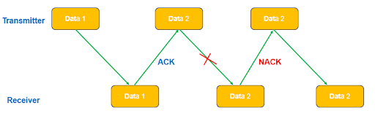
Automatic Repeat Request (ARQ): Working
In ARQ protocol, receiver will send an acknowledgement to sender as soon it receives the frame correctly.
If the sender don’t receive the acknowledgement before timeout, then the sender understand that the frame has been lost/corrupted during transmission.
Thus, sender will retransmits the frame.
This process will continue until the frame is transmitted successfully.

Slide 79
Automatic Repeat Request (ARQ): Types
ARQ Protocols
Stop-and-wait
ARQ
Go-back-N
ARQ
Selective Repeat
ARQ

Slide 80
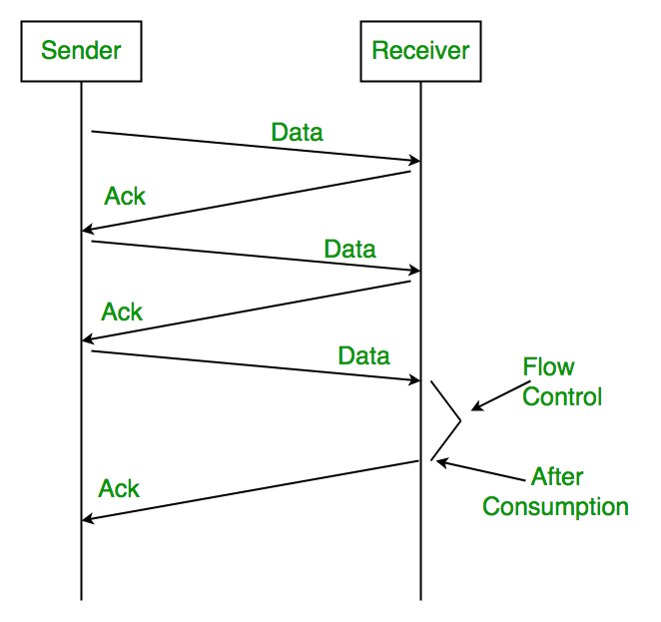
Stop-and-wait ARQ
Stop – and – wait ARQ provides unidirectional data transmission with flow control and error control mechanisms, appropriate for noisy channels.
The sender keeps a copy of the sent frame.
It then waits for a finite time to receive a positive acknowledgement from receiver.
If the timer expires, the frame is retransmitted.
If a positive acknowledgement is received then the next frame is sent.

Slide 81
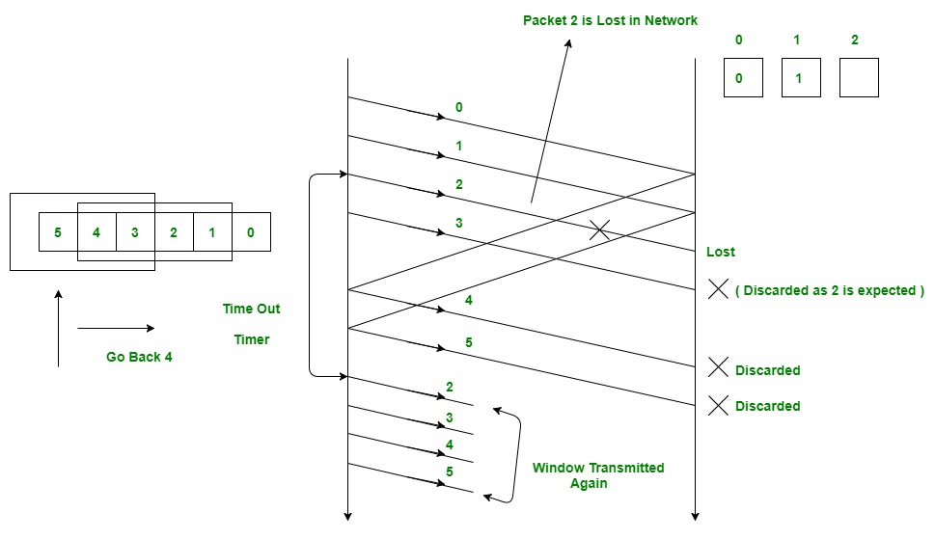
Go-back-N ARQ
Go – Back – N ARQ provides for sending multiple frames before receiving the acknowledgement for the first frame.
It uses the concept of sliding window, and so is also called sliding window protocol.
The frames are sequentially numbered and a finite number of frames are sent.
If the acknowledgement of a frame is not received within timeout period, all frames starting from that frame are retransmitted.

Slide 82
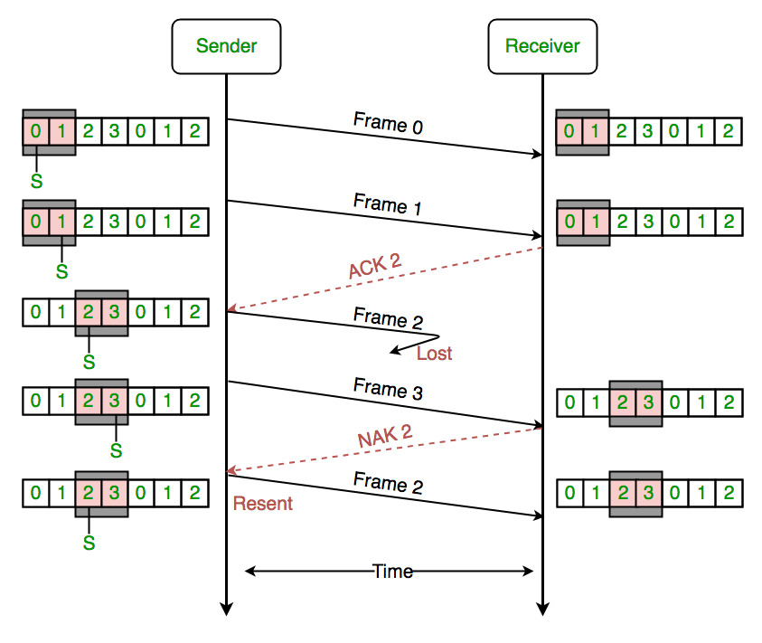
Selective Repeat ARQ
Selective Repeat ARQ also provides for sending multiple frames before receiving the acknowledgement for the first frame.
However, here only the erroneous or lost frames are retransmitted, while the good frames are received and buffered.

Slide 83
GTU Questions: Unit 2-Part 4
Sr. | Question | Marks | Year
1. | Describe Error Control Coding in brief. | 4 | Win’18
2. | How Error Control is implemented using Automatic Repeat Request (ARQ) mechanism? | 7 | Win’19
3. | Enlist and explain Error detection methods in cellular wireless network. | 4 7 | Sum’19 Win’20

Slide 84

References
Book: | Wireless Communications & Networks, Second Edition, William Stallings by Pearson

Slide 85
Thank You

